Slide 1
Network Level Representation of Conceptual Content
Aidas Aglinskas
PhD Candidate
Advisor: Scott Fairhall
April 4, 2019
Notes:
slide for longer

Slide 2
Background
How does the brain represent knowledge?

Slide 3
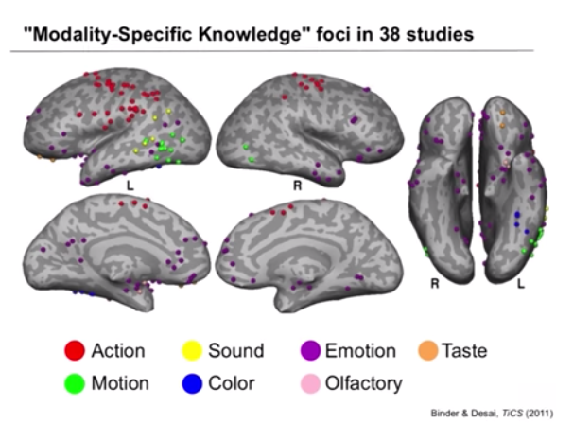
Background: Brain areas involved
Involves Sensory/Motor areas
Activity specific to some words
Binder & Desai (2011)
Notes:
Our knowledge of the world relies, at least in part on, in simulating our experiences with it.
Reading the word ‘thunder’, activates auditory association cortices, ‘hammer’ activates premotor cortices.
In addition, a set of regions are recruited that are outside of sensory motor cortices, involved in general semantic processing

Slide 4
Background: Brain areas involved
Involves Sensory/Motor areas and general semantic systems
Activity specific to some words
Activity common to all words
Binder & Desai (2011)
Binder et al. (2009)
Notes:
How does the brain represent knowledge?
Our knowledge of the world relies, at least in part on, in simulating our experiences with it.
Reading the word ‘thunder’, activates auditory association cortices, ‘hammer’ activates premotor cortices.
In addition, a set of regions are recruited that are outside of sensory motor cortices, involved in general semantic processing

Slide 5
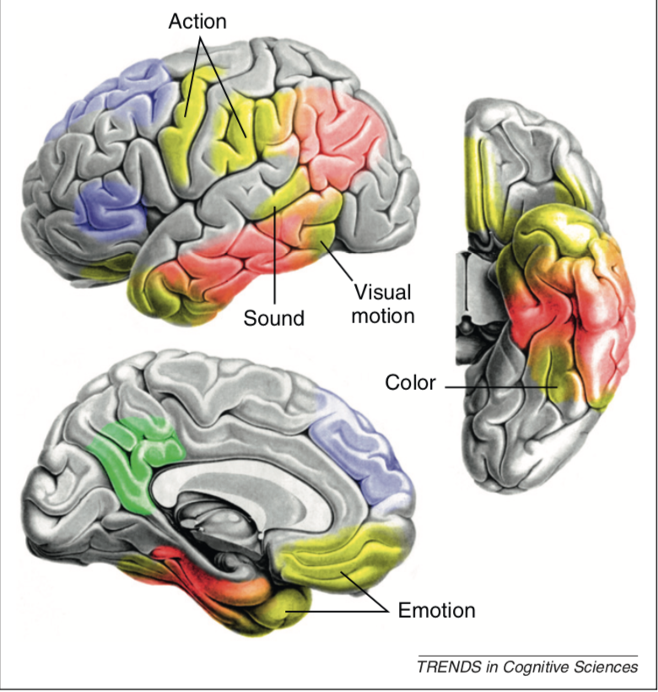
Background: Models
Involves Sensory/Motor areas and general semantic systems
Converge in a hub(s)?
Patterson et al. (2007;2016)
Multiple ‘hubs’; Binder & Desai (2011)

Slide 6
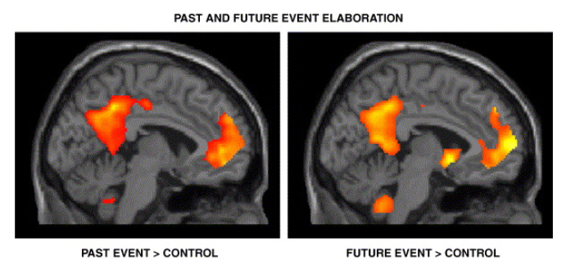
Background: Intrinsic Cognition
Involved in internalised, self-generated thought
Default Mode, Social Cognition & Mental time travel
Regional functions unclear
Semantic Network
Default Mode Network
Social Cognition
Mental time travel
Notes:
This latter proposal is especially important considering that many elements of the extended system fall within one prominent network in the brain, the intrinsic brain network - a collection of brain regions associated with a range of internalised cognitive processes (Spreng et al. 2010). These include not only the eponymous ‘default mode’, task-deactivated states (Raichle et al. 2001) but also a broad range of internalised cognitive processes: general semantic knowledge (Binder et al. 2009; Fairhall and Caramazza 2013b; Huth et al. 2016); social cognition, (Greene et al. 2001; Van Overwalle 2009; 2011), as well as context integration episodic memory and mental time travel (Schacter and Addis 2007; Keidel, Oedekoven, Tut & Bird, 2017). As elements of the internalised cognition network are frequently activated together, establishing specific contributions of each region has proved challenging (Moran et al. 2011; Van Overwalle 2011).

Slide 7
Thesis Aim
To delineate between generality/specialisation in the semantic system
Specifically: Reduntant, independent or complementary functions?
Redundant?
Independent?
Working together?

Slide 8
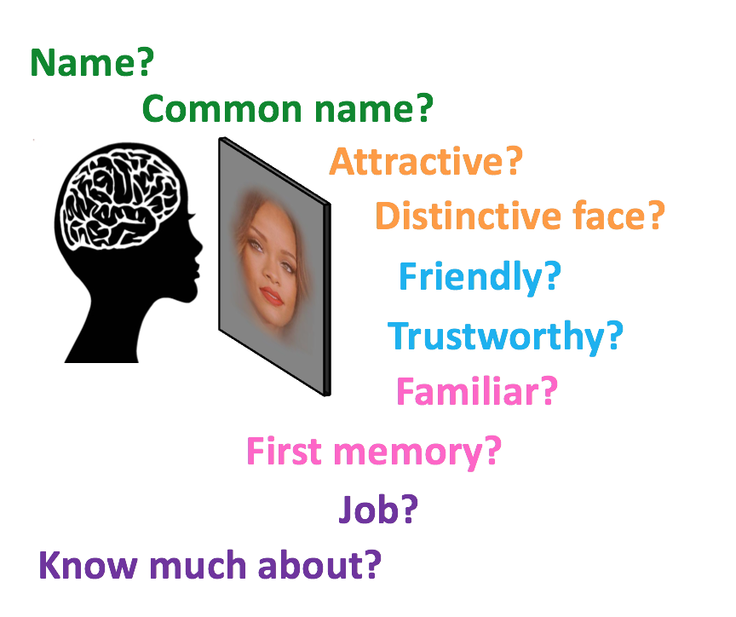
Starting point
Regional functions in simplified scenarious, e.g. person knowledge
Notes:
Systems level behavior, of sem

Slide 9
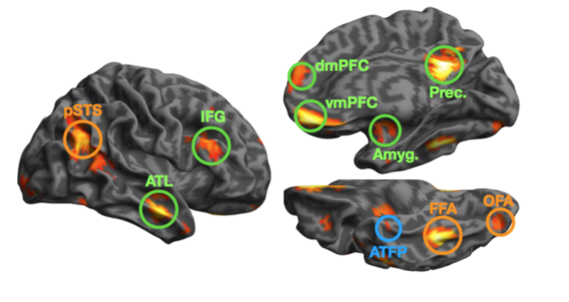
Starting point
Regional functions in simplified scenarious, e.g. person knowledge
Core/Extended person-perception systems
Core
Extended
Unclear
Haxby et al., (2001); Gobbini & Haxby (2007)
Notes:
Systems level behavior, of sem

Slide 10
Starting point
Regional functions in simplified scenarious, e.g. person knowledge
Types of person-knowledge
Core/Extended person-perception systems
Core
Extended
Unclear
Haxby et al., (2001); Gobbini & Haxby (2007)

Slide 11
Starting point: Questions
- Is person knowledge represented in all regions?
- Represented in all regions equally?
- Do regions work together or independently?
- Similarities in the way aspects are represented?
Core
Extended
Unclear
Haxby et al., (2001); Gobbini & Haxby (2007)

Slide 12
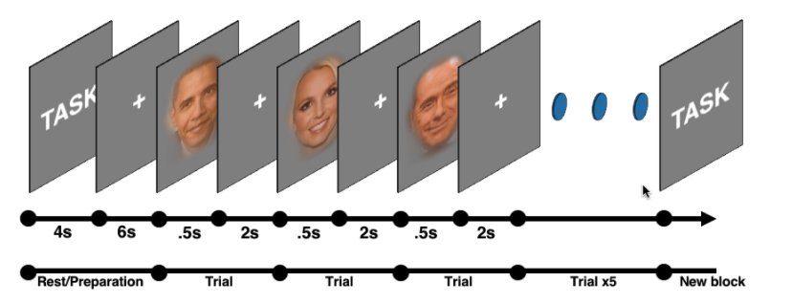
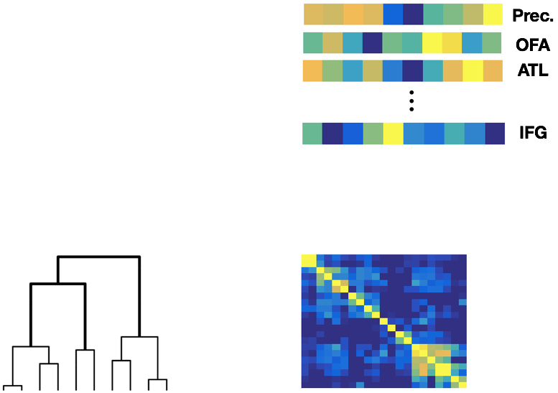
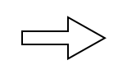

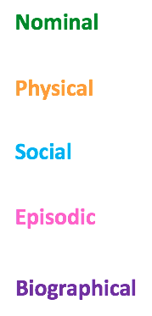
Person-knowledge: Methods
Schema of the experiment
GLM
Regional activation pattern
Independent ROIs (n=42)
Task
Attractiveness
Occupation
cognition specific brain map
Response magnitude
Occupation?
Notes:
this allows us to see if dif regions for dif person knowledge

Slide 13
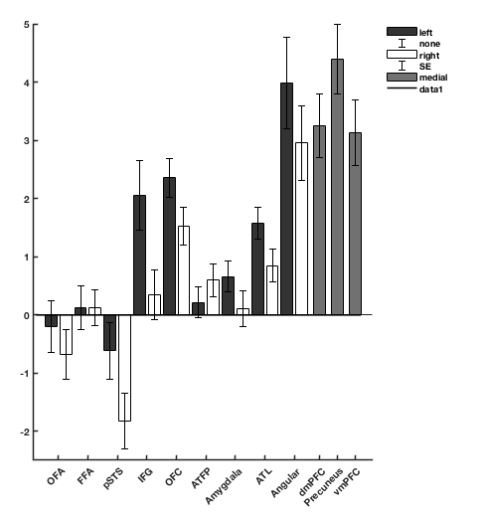
Is person knowledge represented in all regions?
Left
*
***
*
p < .05
***
Right
**
**
p < .01
Medial
***
p < .001
***
***
***
**
***
response magnitude (β)
***
***
*
**
*
**
Core
Extended
Notes:
- Perceiving faces is right, retrieving knowledge about engaged the left.
- Regions respond to more than one domain
- Any cognition involves multiple regions.

Slide 14
Is person knowledge represented in all regions?
Left
*
***
*
p < .05
***
Right
**
**
p < .01
Medial
***
p < .001
***
***
***
**
***
response magnitude (β)
***
***
*
**
*
**
Core
Extended
Notes:
- Perceiving faces is right, retrieving knowledge about engaged the left.
- Regions respond to more than one domain
- Any cognition involves multiple regions.

Slide 15
Is person knowledge represented in all regions?
Left
*
***
*
p < .05
***
Right
**
**
p < .01
Medial
***
p < .001
***
***
***
**
***
response magnitude (β)
***
***
*
**
*
**
Core
Extended
Notes:
- Perceiving faces is right, retrieving knowledge about engaged the left.
- Regions respond to more than one domain
- Any cognition involves multiple regions.

Slide 16
Starting point: Questions
Q: Is person knowledge represented in all regions?
Q:Represented in all regions equally?
Q:Do regions work together or independently?
Q:Similarities in the way aspects are represented?

Slide 17
Starting point: Questions
Q: Is person knowledge represented in all regions?
A: Person knowledge engages extended, but not core regions
Q:Represented in all regions equally?
Q:Do regions work together or independently?
Q:Similarities in the way aspects are represented?

Slide 18
Starting point: Questions
Q: Is person knowledge represented in all regions?
A: Person knowledge engages extended, but not core regions
Q:Represented in all regions equally?
Q:Do regions work together or independently?
Q:Similarities in the way aspects are represented?

Slide 19
Represented in all regions equally?
Left
*
***
*
p < .05
***
Right
**
**
p < .01
Medial
***
p < .001
***
***
***
**
***
response magnitude (β)
***
***
*
**
*
**
Core
Extended
Notes:
- Perceiving faces is right, retrieving knowledge about engaged the left.
- Regions respond to more than one domain
- Any cognition involves multiple regions.

Slide 20
Represented in all regions equally?
Left
*
***
*
p < .05
***
Right
**
**
p < .01
Medial
***
p < .001
***
***
***
**
***
response magnitude (β)
***
***
*
**
*
**
Core
Extended
Notes:
- Perceiving faces is right, retrieving knowledge about engaged the left.
- Regions respond to more than one domain
- Any cognition involves multiple regions.

Slide 21
Represented in all regions equally?
Left
*
***
*
p < .05
***
Right
**
**
p < .01
Medial
***
p < .001
***
***
***
**
***
response magnitude (β)
***
***
*
**
*
**
Core
Extended
Notes:
- Perceiving faces is right, retrieving knowledge about engaged the left.
- Regions respond to more than one domain
- Any cognition involves multiple regions.

Slide 22
Person-knowledge: Neural mechanisms
Notes:
- Perceiving faces is right, retrieving knowledge about engaged the left.
- Regions respond to more than one domain
- Any cognition involves multiple regions.

Slide 23
Person-knowledge: Neural mechanisms
Notes:
- Perceiving faces is right, retrieving knowledge about engaged the left.
- Regions respond to more than one domain
- Any cognition involves multiple regions.

Slide 24
Starting point: Questions
Q: Is person knowledge represented in all regions?
A: Person knowledge engages extended, but not core regions
Q:Represented in all regions equally?
Q:Do regions work together or independently?
Q:Similarities in the way aspects are represented?

Slide 25
Starting point: Questions
Q: Is person knowledge represented in all regions?
A: Person knowledge engages extended, but not core regions
Q:Represented in all regions equally?
A:While involved in most-all cognitions, regions show a ‘tuned’ response
Q:Do regions work together or independently?
Q:Similarities in the way aspects are represented?

Slide 26
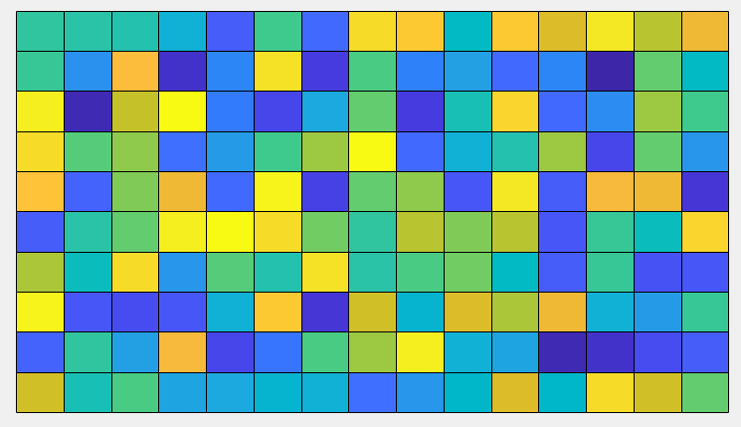
Person-knowledge: netRSA
High response
Name?
Common name?
Attractive?
Distinctive face?
Friendly?
Trustworthy?
Regional response
Familiar?
First memory?
Job?
Know much about?
Brain regions
Low response
Pairwise Regional Similarity

Slide 27
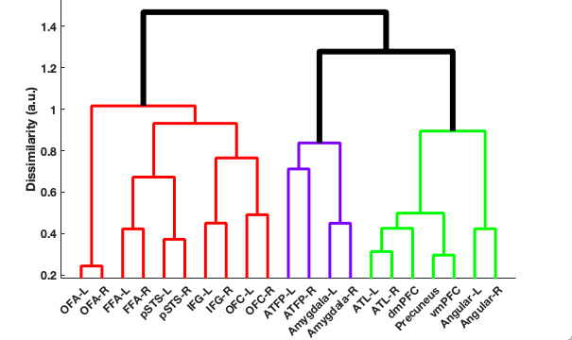




Do regions work together or independently?
Function Similarity Matrix
Function Similarity Dendrogram
.75
Regions
similarity (r)
- .09
RSA models
** p < .01
**
Model evidence
Core
Frontolateral
Mediotemporal
Intrinsic
Modelled
Not modelled

Slide 28
Starting point: Questions
Q: Is person knowledge represented in all regions?
A: Person knowledge engages extended, but not core regions
Q:Represented in all regions equally?
A:Tuned response
Q:Do regions work together or independently?
Q:Similarities in the way aspects are represented?

Slide 29
Starting point: Questions
Q: Is person knowledge represented in all regions?
A: Person knowledge engages extended, but not core regions
Q:Represented in all regions equally?
A:Tuned response
Q:Do regions work together or independently?
A: Internalised cognition and Fronto-Lateral regions perform different functions
Q:Similarities in the way aspects are represented?

Slide 30
Person-knowledge: netRSA
Name?
Pairwise Cognitive Similarity
Common name?
Attractive?
Distinctive face?
Friendly?
Trustworthy?
Familiar?
First memory?
Job?
Know much about?
Pairwise Regional Similarity

Slide 31
Person-knowledge: Cognitive state representation
Network similarity
.75
Tasks
similarity (r)
Dissimilarity (a.u.)
.5
Semantic +
Episodic
Nominal
Cognitive models
***
Modelled
Not modelled
*** p < .001
Episodic
Semantic
Nominal
Physical
Social

Slide 32
Starting point: Questions
Q: Is person knowledge represented in all regions?
A: Person knowledge engages extended, but not core regions
Q:Represented in all regions equally?
A:Tuned response
Q:Do regions work together or independently?
A: Internalised cognition and Fronto-Lateral regions perform different functions
Q:Similarities in the way aspects are represented?

Slide 33
Starting point: Questions
Q: Is person knowledge represented in all regions?
A: Person knowledge engages extended, but not core regions
Q:Represented in all regions equally?
A:Tuned response
Q:Do regions work together or independently?
A: Internalised cognition and Fronto-Lateral regions perform different functions
Q:Similarities in the way aspects are represented?
A: Yes, e.g. Episodic and Biographical person knowledge are represented simlarly

Slide 34
Interim Conclusions
Person knowledge engages extended, but not core regions
Extended regions involved in all cognitions, with tuned response
Internalised cognition and Fronto-Lateral regions perform different functions
Network pattern of response is informative about knowledge being accessed
What is the role of perception in person-knowledge?
- Is person knowledge representation stable across modalities of presentation?

Slide 35
Person-knowledge: Names
- 24 new subjects, Name stimuli
- Same tasks/experimental parameters
Q: Is person knowledge representation stable across modalities of presentation?

Slide 36
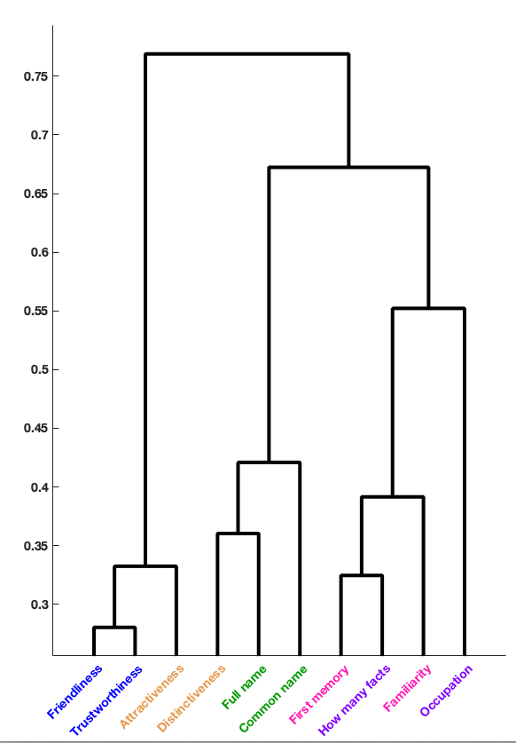

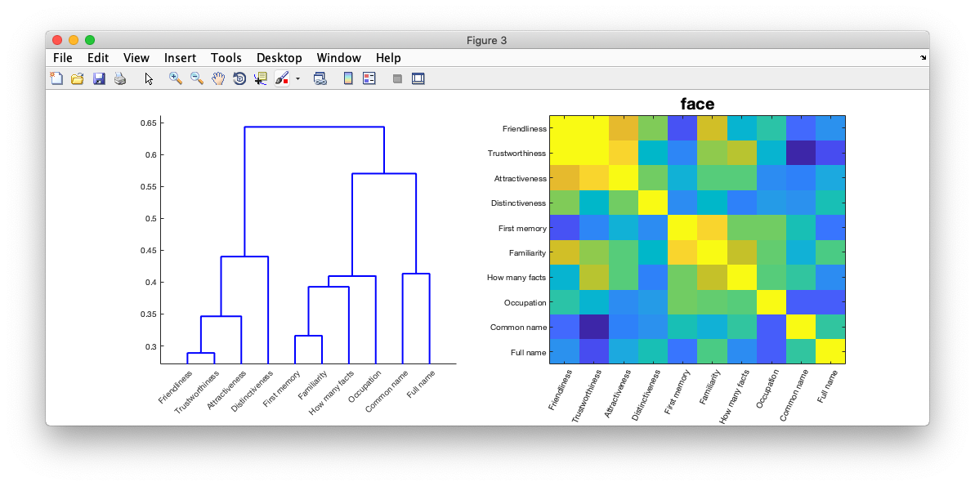
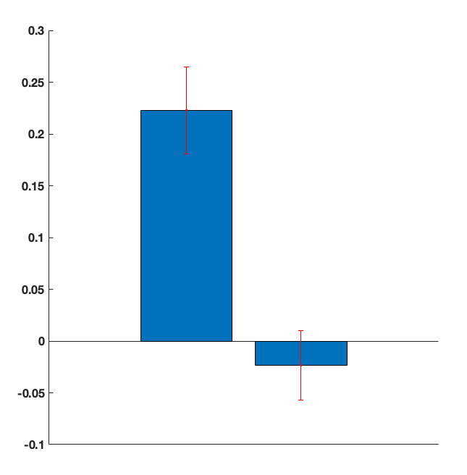
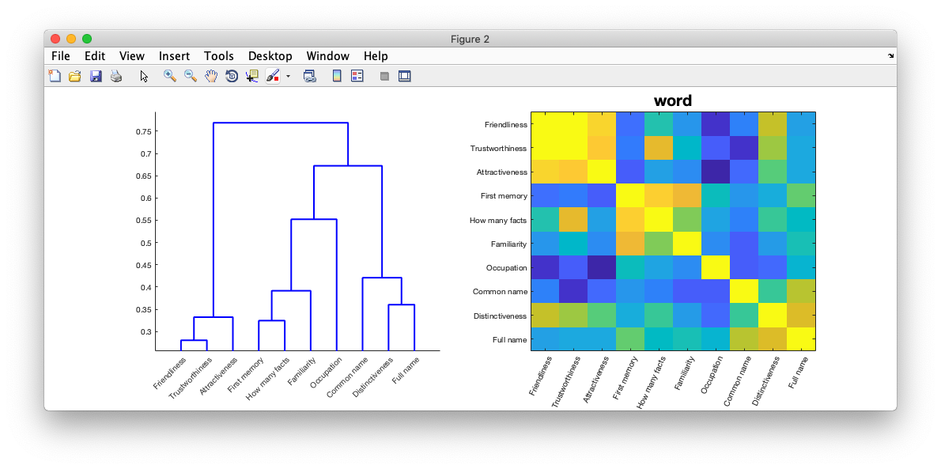
Person-knowledge stable across modalities?
Task similarity
Task similarity
Task similarity
Face viewing
Data-model correlation
dissimilarity
dissimilarity
r
Correlate
Task similarity
Name reading
Extended
Core
Cognitive state is stably represented in extended (but not core) element
Notes:
Cognitive patterns are largely stable.

Slide 37
Person-knowledge: Role of perception
Q: Is person knowledge representation stable across modalities of presentation?

Slide 38
Person-knowledge: Role of perception
Q: Is person knowledge representation stable across modalities of presentation?
A: Person knowledge is stable within the extended, but not core regions
Specific only to people?
- Is knowledge about objects similarly distributed?

Slide 39
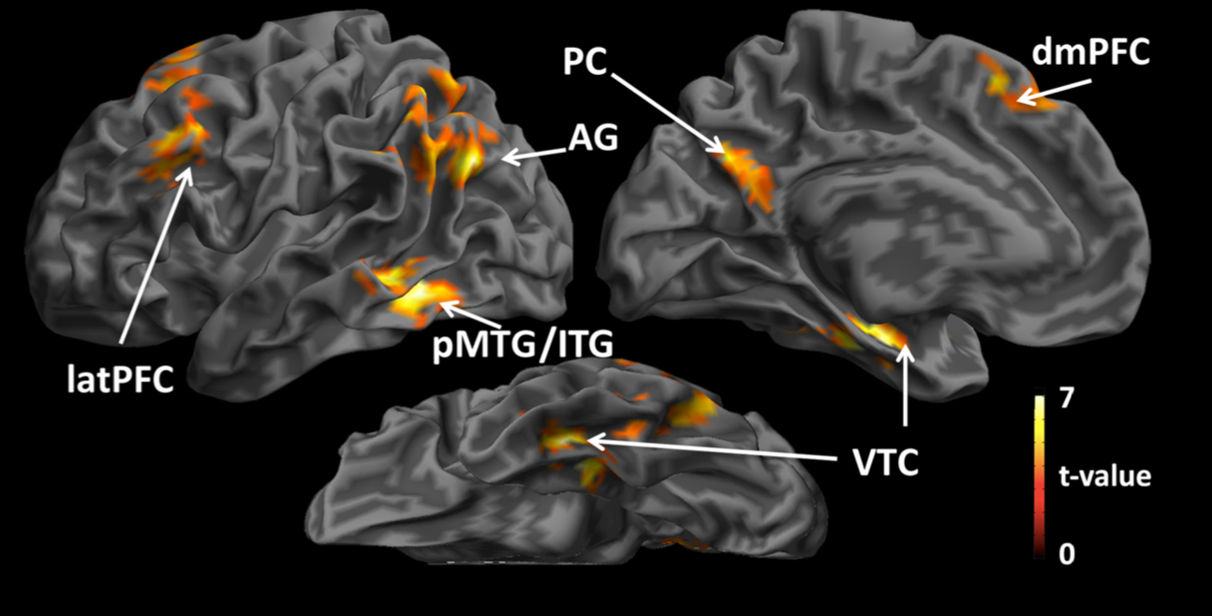
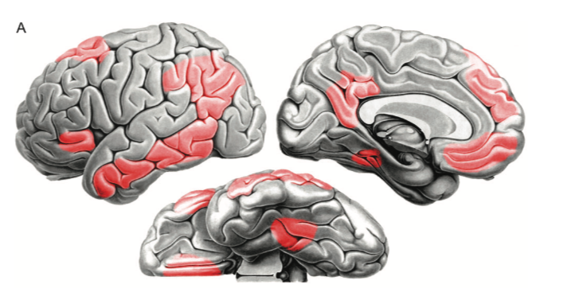
Object knowledge
-Object knowledge represented in one or multiple regions?
- Same or different type of knowledge represented?
Fairhall and Caramazza, 2013
Binder et al. 2009
Notes:
previously showed that multiple regions, represent multiple object knowledge, differs acorss regions?

Slide 40
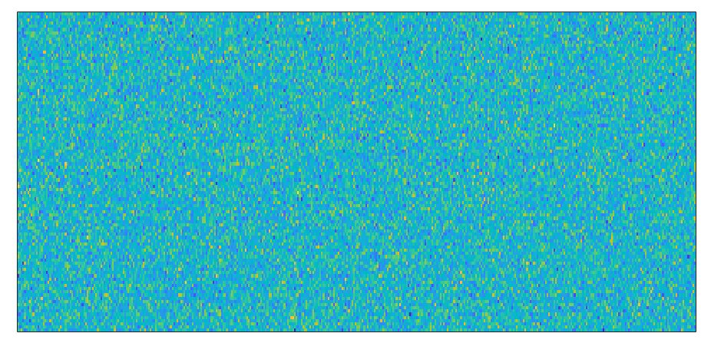
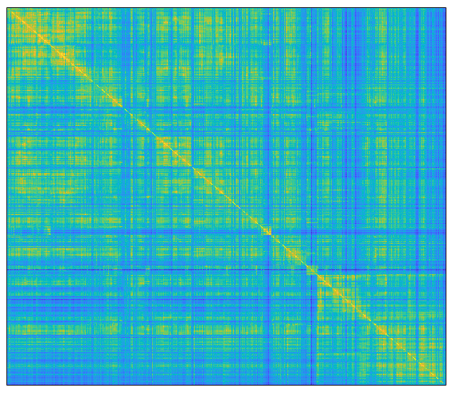
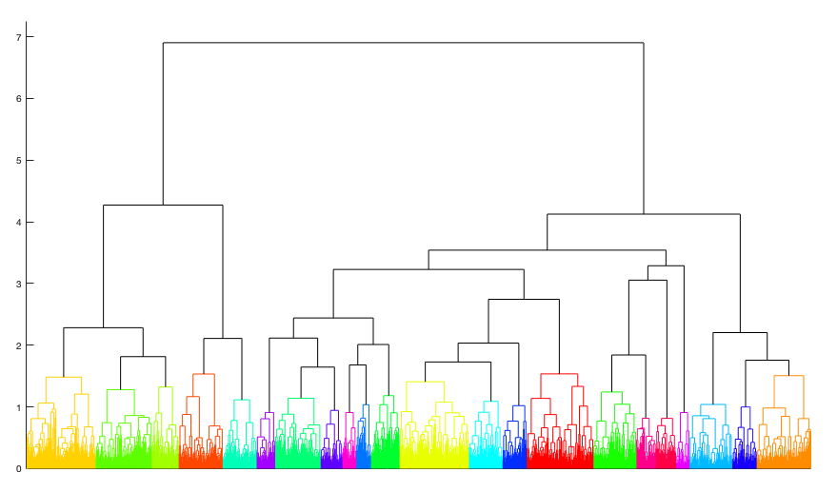
Object knowledge: Stimuli & Model
Stimuli selection goal: naturally occuring (in text) concrete noun categories
Word Co-occurence matrix (source, wikipedia)
Noun similarity matrix
similarity grouping
r = Noun similarity
high
1400 nouns
Co-ocurence
nouns
Noun dissimilarity
6700 Co-occuring words
low
nouns
nouns

Slide 41
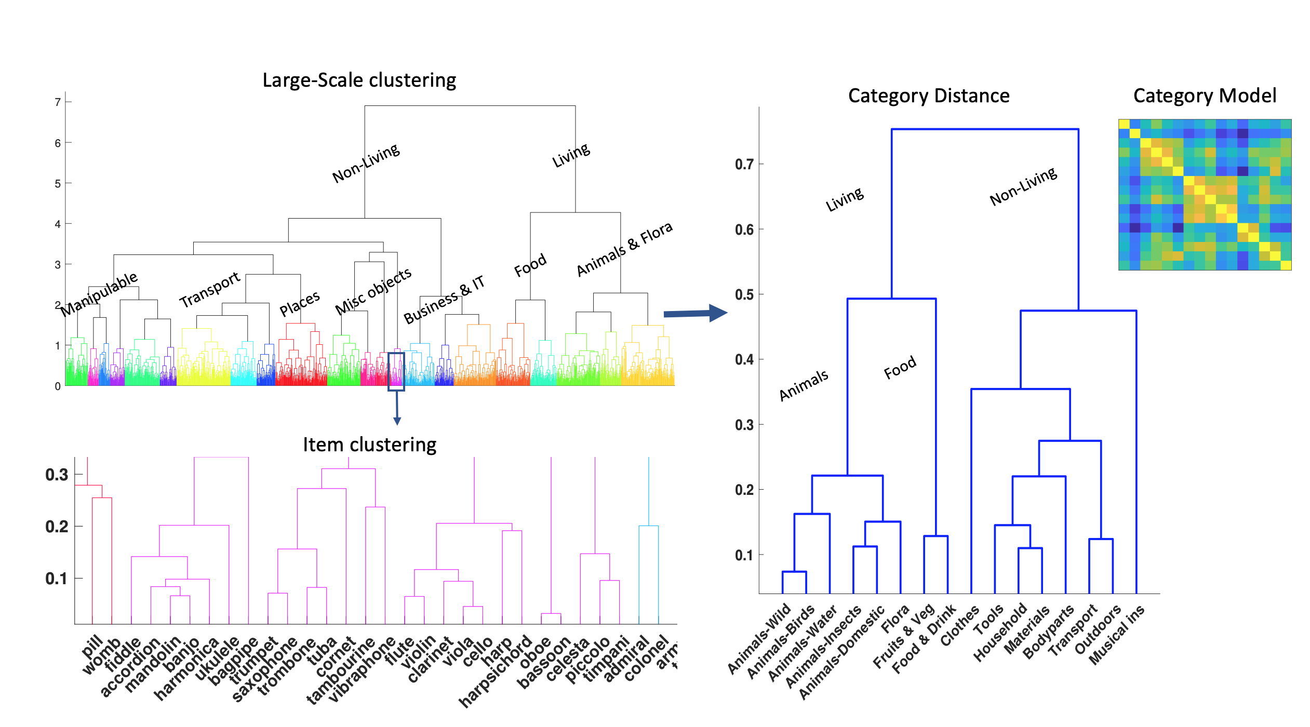
Object knowledge: Stimuli & Model
Noun dissimilarity
Stimuli: 24 for each category
Task: Typicality
Control: Function words

Slide 42
Object knowledge: Results
Activation in general semantic system
Regions defined using ANOVA contrast
All categories vs. control. p < .001; extent > 20
Omnibus ANOVA, p < .001; extent > 5

Slide 43
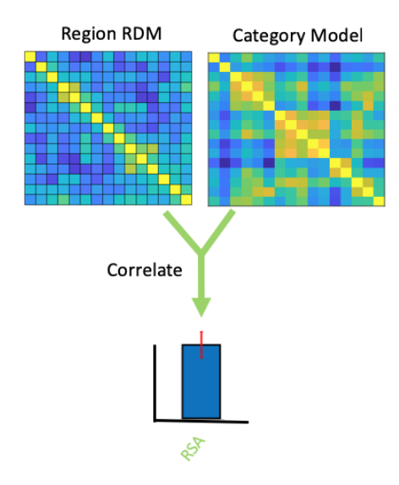
Object knowledge: Regional RSA
Similarly represented?
Object categories
Region Voxels

Slide 44
Object knowledge: Results
Knowledge representation in OFC, pMTG & PHG
Correlation with model

Slide 45
Object knowledge
Q:Object knowledge represented in one or multipe regions?
Q:Same or different type of knowledge represented?

Slide 46
Object knowledge
Q:Object knowledge represented in one or multipe regions?
A:Multiple regions represent object knowledge
Q:Same or different type of knowledge represented?

Slide 47
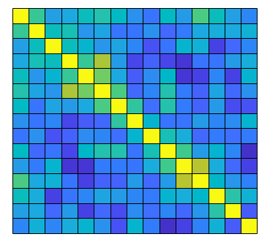
Object knowledge: Regional RSA
Object categories
RSA
Region Voxels

Slide 48
Object knowledge: Regional RSA
Object categories
RSA
Region Voxels

Slide 49
Object knowledge: Regional RSA
Object categories
RSA
Region Voxels

Slide 50
Object knowledge: Regional RSA
netRSA
Object categories
RSA
Region Voxels

Slide 51
Object knowledge: Regional RSA
netRSA
Object categories
RSA
Regions

Slide 52
Object knowledge: Regional RSA
Object categories
Regions
?

Slide 53
Object knowledge: Regional RSA
Object categories
Regions
*
NetRSA > RSA: t(17) = 2.40,p = 0.028

Slide 54
Object knowledge: Regional RSA
Object categories
Regions
Non-reduntant information
*
NetRSA > RSA: t(17) = 2.40,p = 0.028

Slide 55
Interim Summary
- Object knowledge is represented in multiple brain regions
- Information within semantic regions is non-redundant

Slide 56
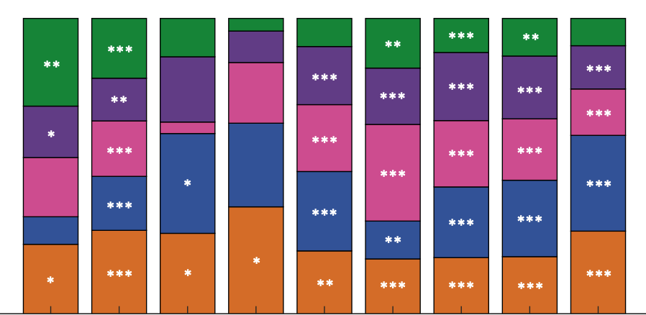
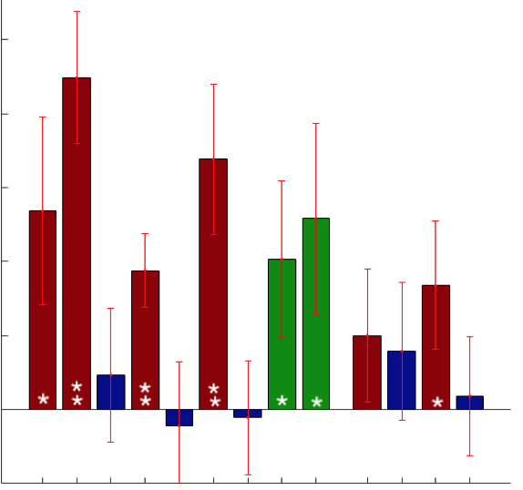

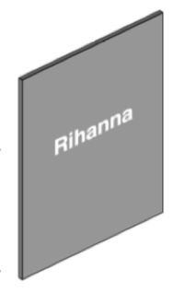
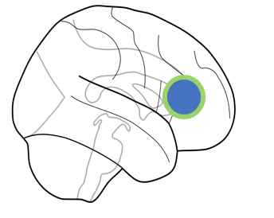
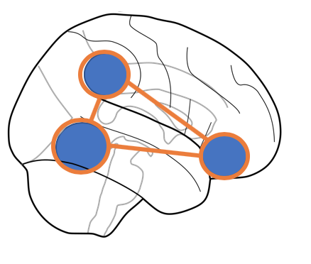
Summary of findings (Person & Object knowledge)
- General: Different semantic information (person and object knowledge) are represented in overlapping neural substrates
- Tuned: While responding to most kinds of knowledge, regions have different preferences
- Stable: person-knowledge representation is stable across modalities, conceptual in nature
- Distributed: Regional preferences are complementary, contributing to larger representation.

Slide 57
General Conclusions: Person & Object knowledge
- Multiple sources of information are represented in multiple ‘hubs’
- Non-redundant, complementary system
- Regions work together for an even more complex representation?
Independent?
Redundant?
Working together
Multiple ‘hubs’; Binder & Desai (2011)
Notes:
Whats new, whats the impact

Slide 58
Further Directions
- Feature spaces explaning regional/group behavior?
- Functional connectivity changes?
- Sentence processing?

Slide 59
Aknowledgements
Lab:
Scott Fairhall (PI)
Silvia Ubaldi (Postdoc)
Elisa Leonardelli (Postdoc)
Gabriella Liuzzi (Postdoc)
David Acunzo (Postdoc)
Nat Bertelsen (RA)

Slide 60
End of Slides

Slide 61
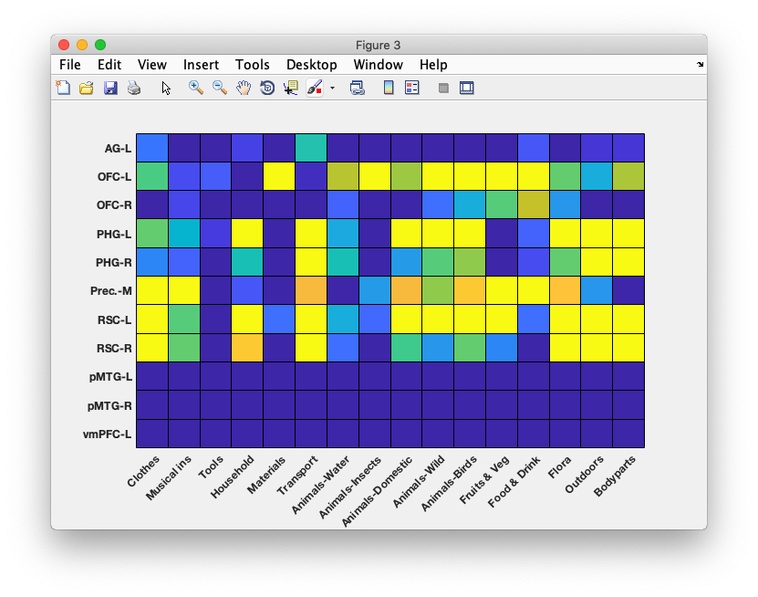
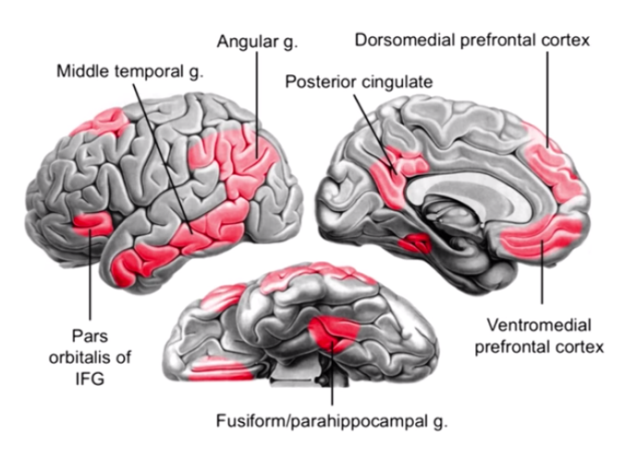
Object knowledge: Results
T value matrix: Category > Control
- Semantic system broadly tuned
4
2

Slide 62
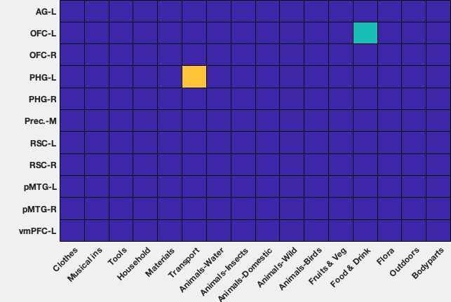
Object knowledge: Results
Regional Preference matrix
Sum = 100%
- Semantic system broadly tuned
- Some category prefference
- Most categories distributed
1/8
1/16

Slide 63
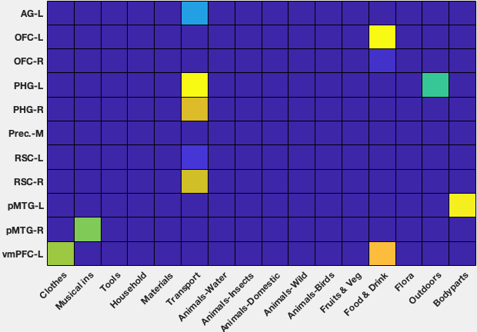
Regions respond to multiple categories
Some strong category prefferences

Slide 64
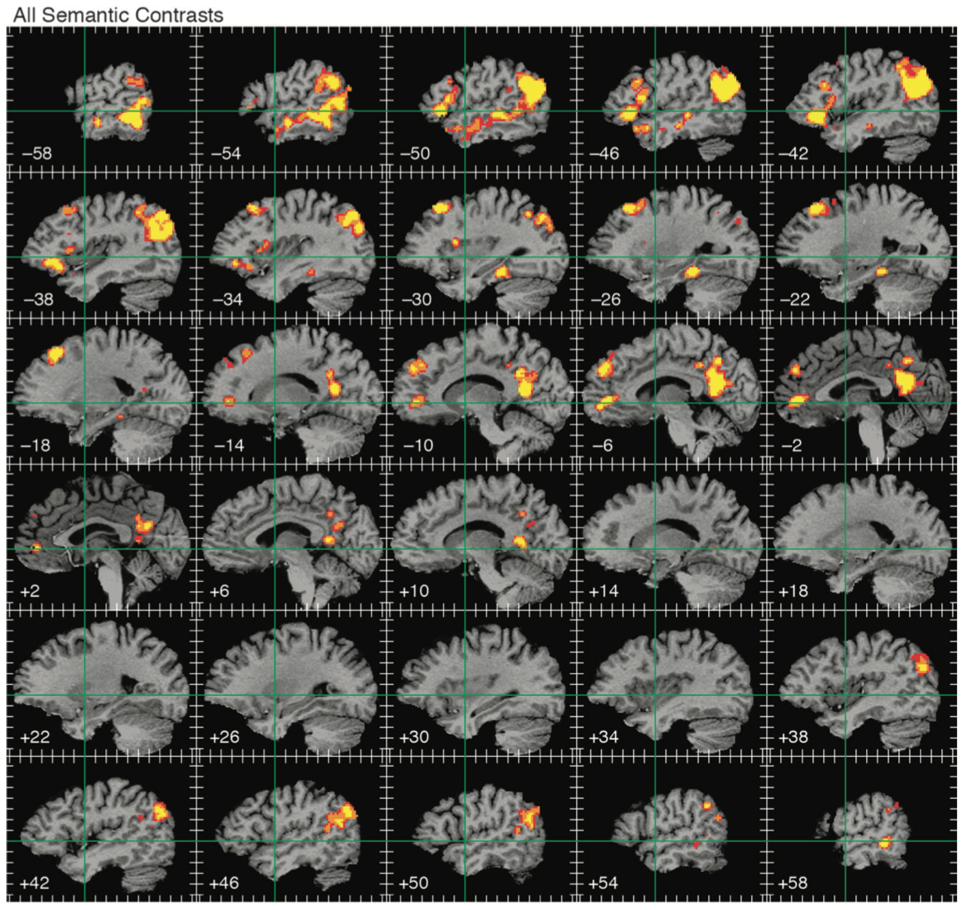

Slide 65
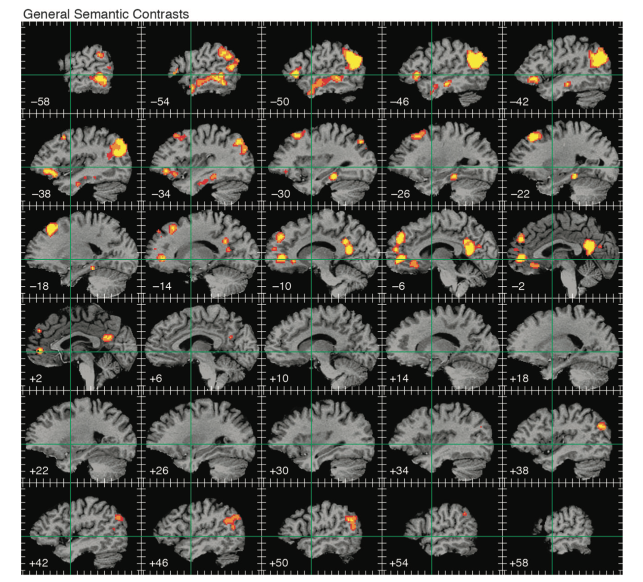

Slide 66
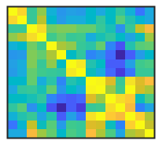
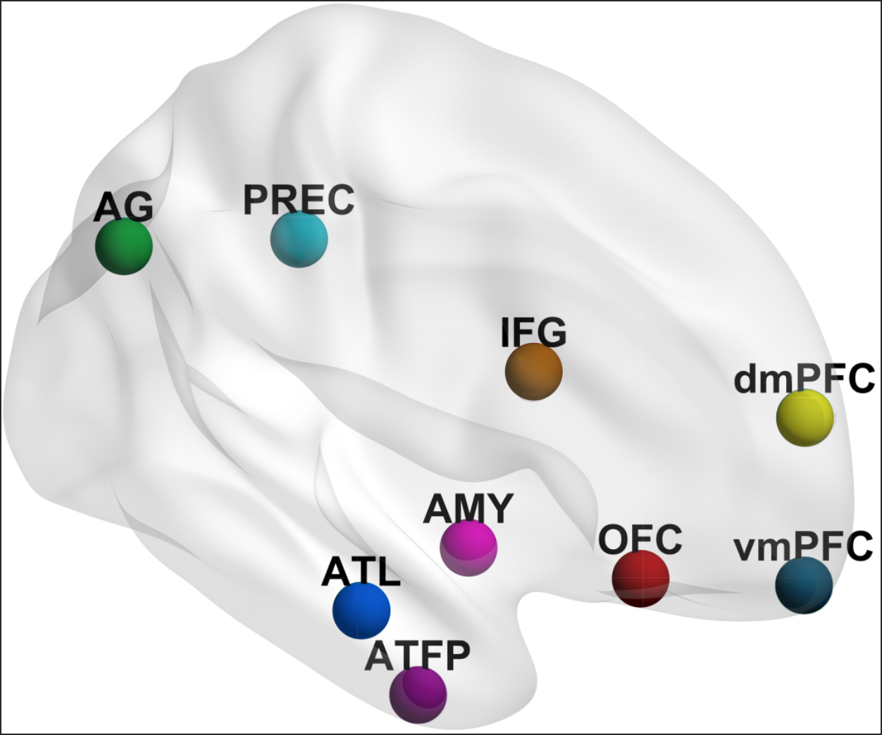
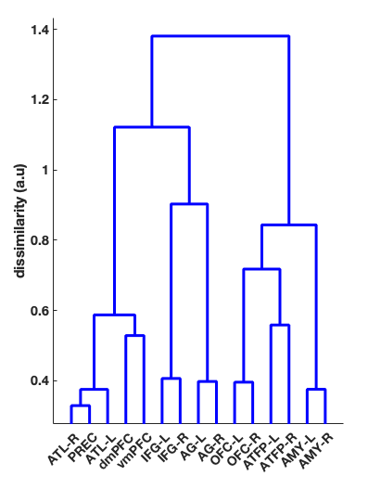
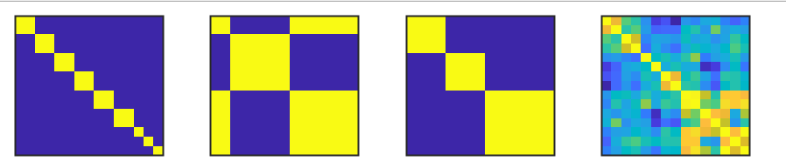
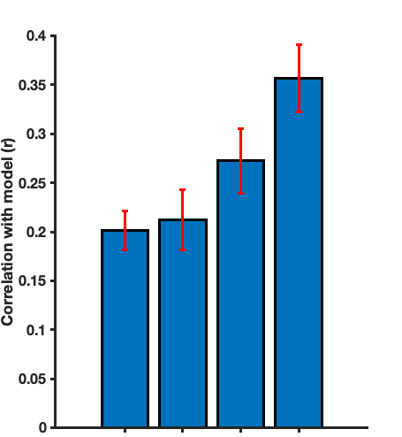
Names: Regional Similarity Dendrogram
Pattern Similarity Matrix
Pattern similarity
Model fit
Pairs
Posthoc
Model fit comparison
*
**
**
*
* p < .05
*
** p < .001
n.s
Internalised/Externalised/Control
Empirical
Pairs
I/E/C
Posthoc
Empirical

Slide 67
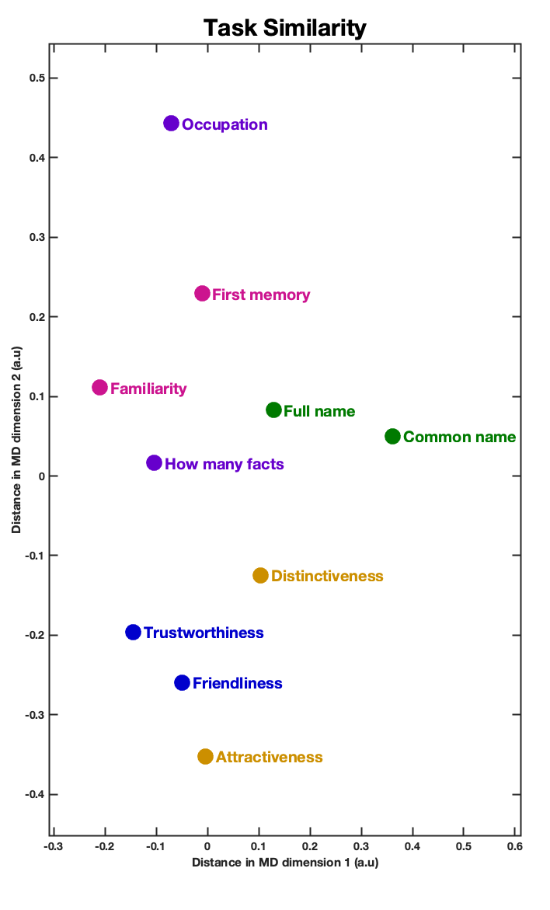
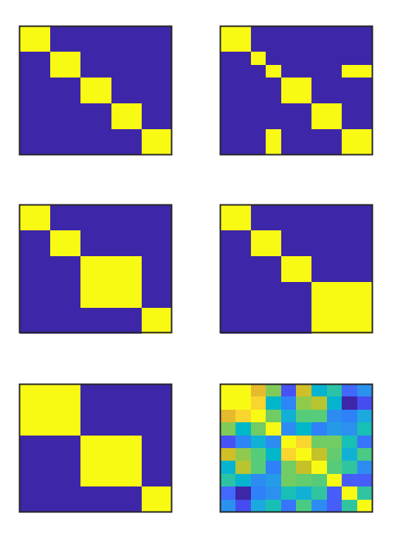
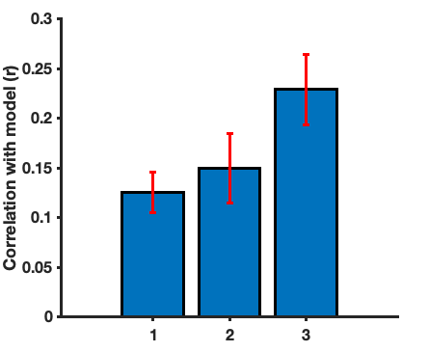
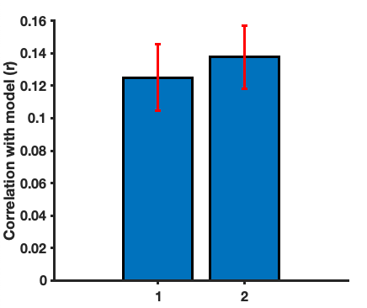
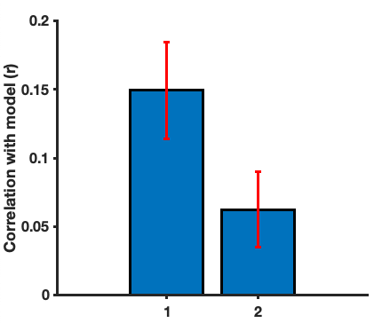
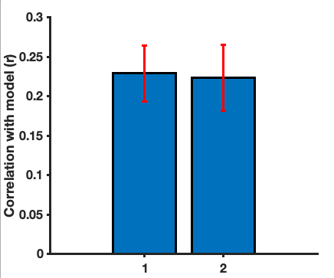

Names: Model comparison Procedure
Pairs
Episodic+Biographical
Macro-Domain
**
**
Similarity model fit
Pairs posthoc
Episodic+Nominal
Empirical Model
Pairs
Ep+Bio
Model Visualisation
Macro-Domain
Best Model Macro Domain Grouping
Social/Perceptual judgements
n.s
*
n.s
Memory
Pairs
Ep+Bio
Nominal Knowledge
Pairs posthoc
Ep+Nom
Macro-Domain
Empirical Model

Slide 68
Person-knowledge: Organisation?
- How are different person-knowledge attributes related to each other?
- Are they independent or related to each other
- Use it to infer brain representations?

Slide 69
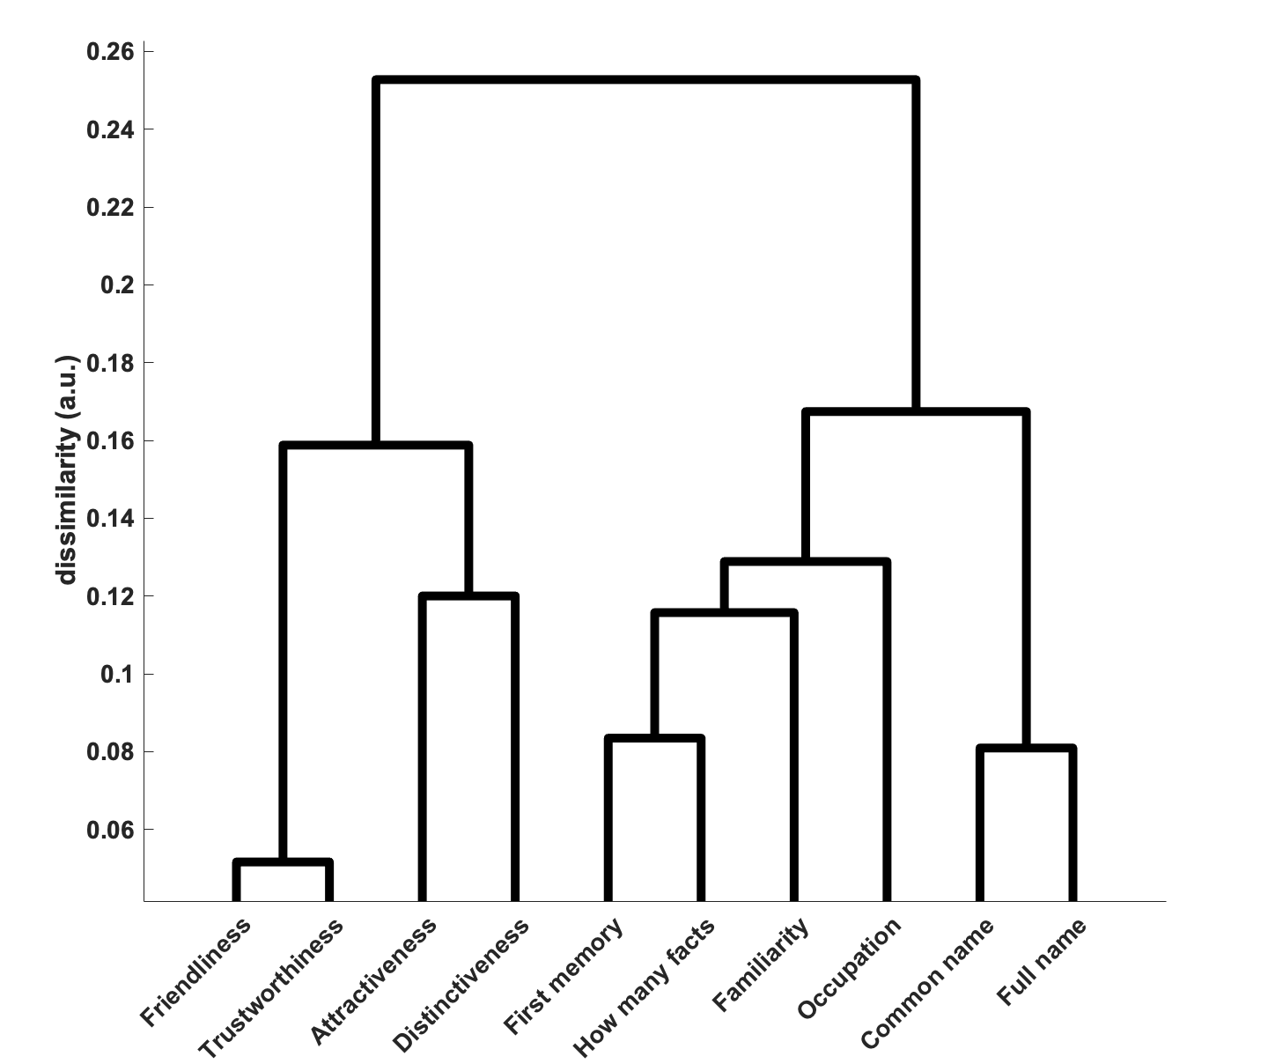
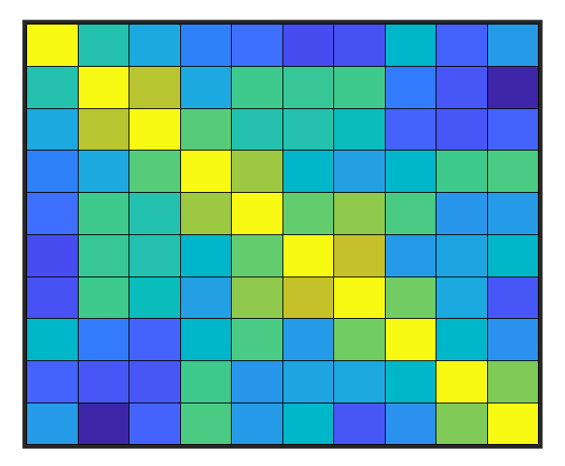
Person-knowledge: Explicit similarity
d)
Hierarchical Clustering
c)
Subjective task similarity

Slide 70
Person-knowledge: Implicit similarity
Reaction time
Similarity Matrix
Tasks
Tasks
Response
Similarity Matrix
Tasks
Tasks

Slide 71
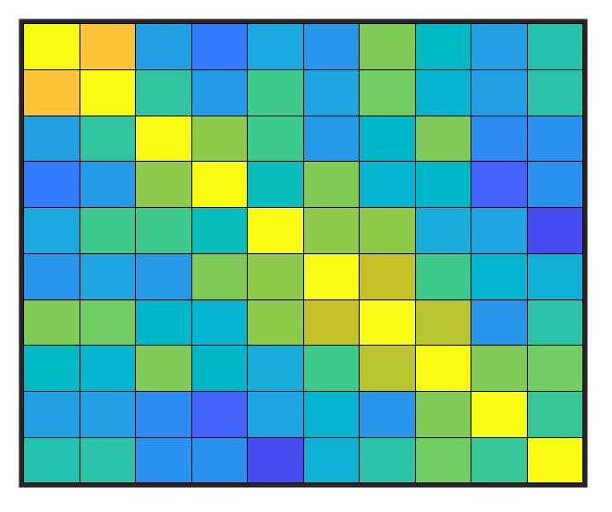
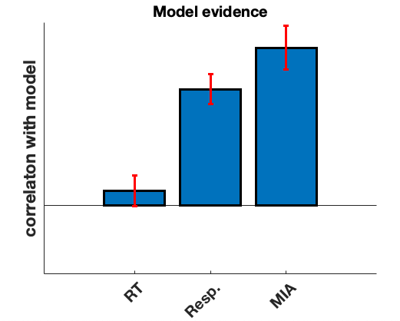


Person-knowledge: Measure Comparison
RT similarity
Model comparison
High
n.s.
p > .05
**
p < .001
Response similarity
Similarity model
**
Similarity (r)
**
Low
n.s.
MIA
**
Modelled
**
Not modelled

Slide 72



Object knowledge: Results
*
netRSA fit: t(17) = 3.82,p = 0.001
netRSA > RSA: t(17) = 2.40,p = 0.028

Slide 73

Person knowledge: Beyond person perception netwrok
Domain Specific Activation
p < .001 (voxel); p < .05 (FWE, cluster corrected)
Nominal
Physical
Social
Episodic

Slide 75


Chapter 3: Names

Slide 76








Person-knowledge: Names
Faces
Names
- Name stimuli, 24 new subjects
- Same tasks/ experimental parameters
- Broadly similar activation patterns
- Activates common and distinct regions
Voxel p < .001
Cluster p < .05
All task > face/name 1-back

Slide 77
Person-knowledge: Role of perception
- Extended system regions respond to names
- Larger response for face viewing
- Knowledge representation the same?

Slide 78


Person-knowledge: Role of perception

Slide 79
Person-knowledge: Role of perception

Slide 80
Person-knowledge: Role of perception
Stable cognitive tuning
Flexible cognitive tuning

